Slide 1
TrainLine – Travelling made Easier!
Project Made By :-
Abhishek Pandey (14/CSE/100)
Muddassir Zafar (14/CSE/068)
Shivangi Prasad (14/CSE/092)
Soma Samanta (14/CSE/102)

Slide 2
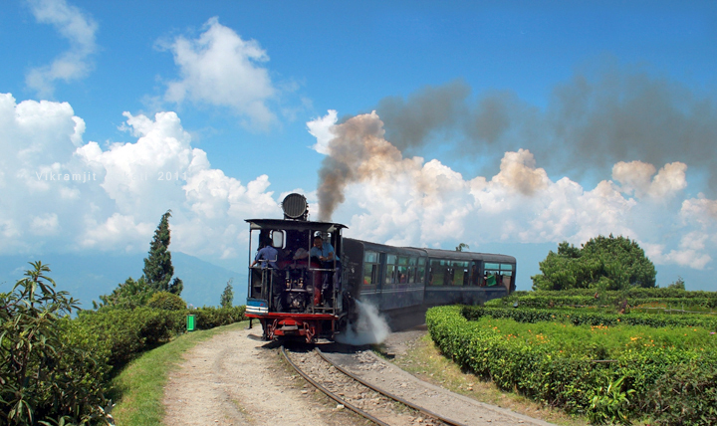
TrainLine is a project made by us with the main aim of providing comfort at your doorstep. These days it has become very difficult for people to get a reserved berth in any train due to the huge population rush. TrainLine helps people secure a seat in their desired train just through a series of mouse-clicks. There’s no need for you to step out of your home in this scorching heat anymore! All you need is right in front of your screen. ☺

Slide 3
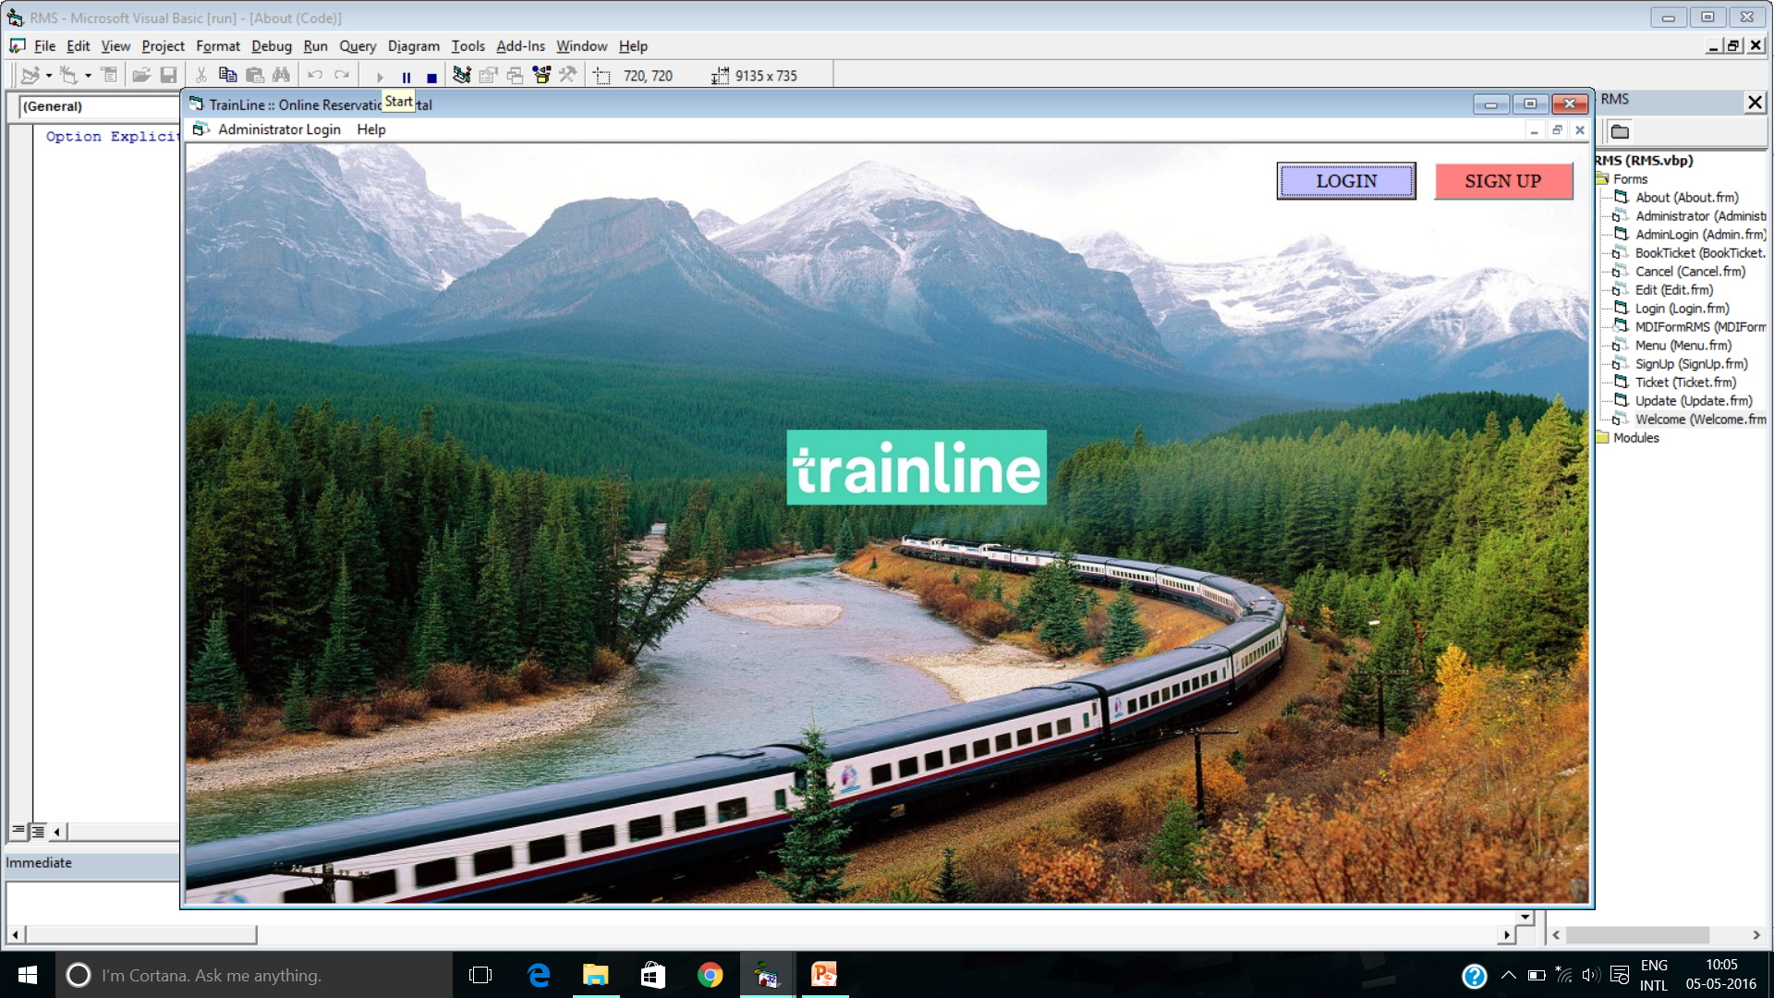
Welcome to TrainLine

Slide 4
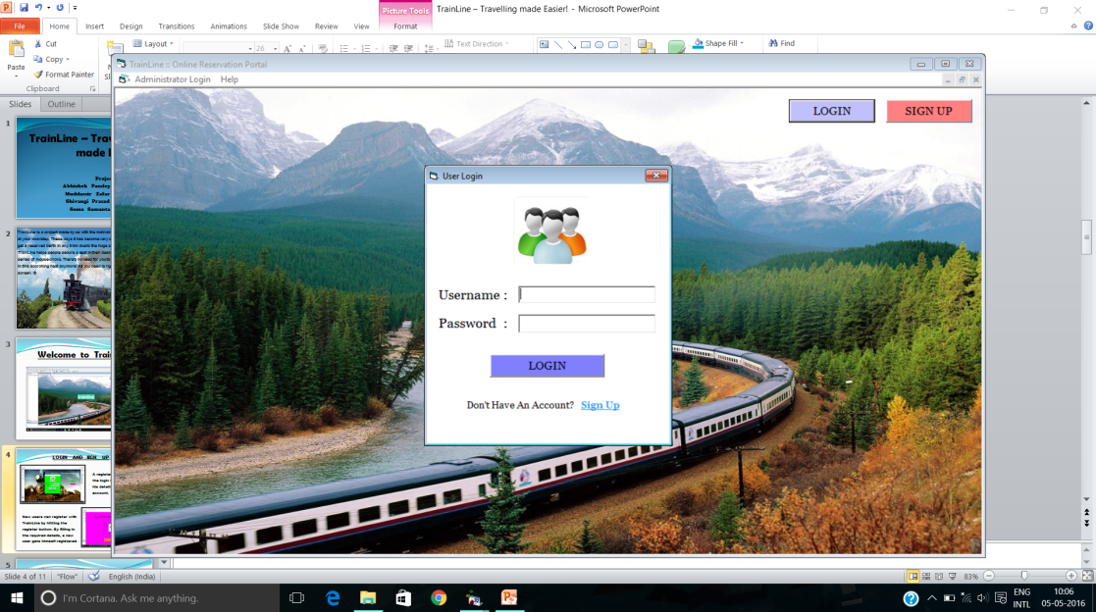
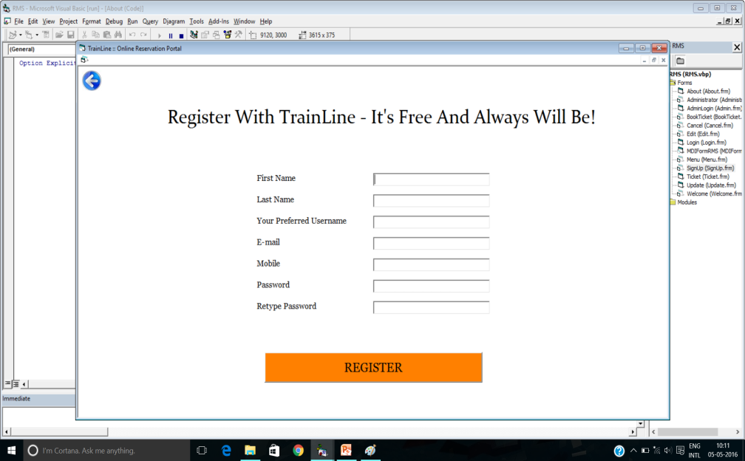
LOGIN AND SIGN UP
A registered user clicks on the login button and enters his details to access his account.
New users can register with TrainLine by hitting the register button. By filling in the required details, a new user gets himself registered.

Slide 5
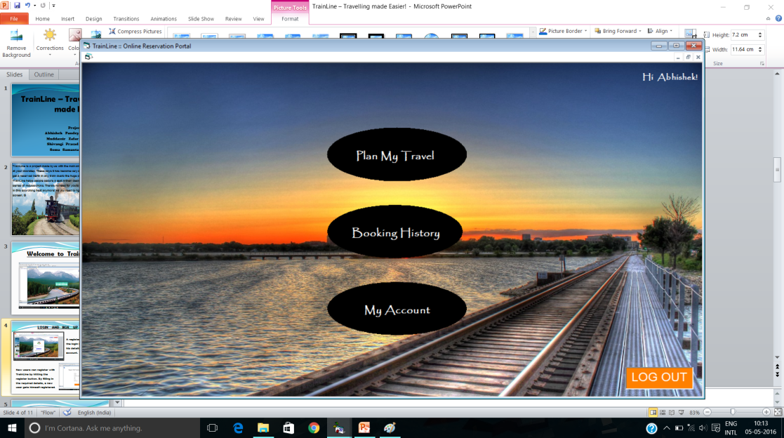
MENU
Plan My Travel
Booking History
My Account
This menu is generated for any registered user after they login. A TrainLine user can:
Plan his travel by entering his source station and destination station as well as date of journey , check availability and book ticket.
Keep a track of his booked tickets through the Booking History feature.
Change the details such as name, username, password or any other detail.

Slide 6
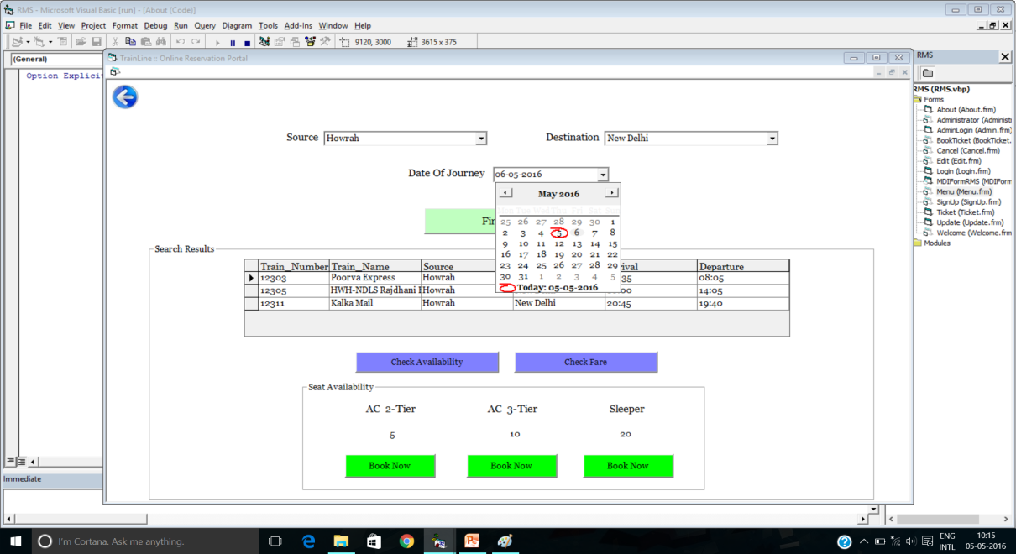
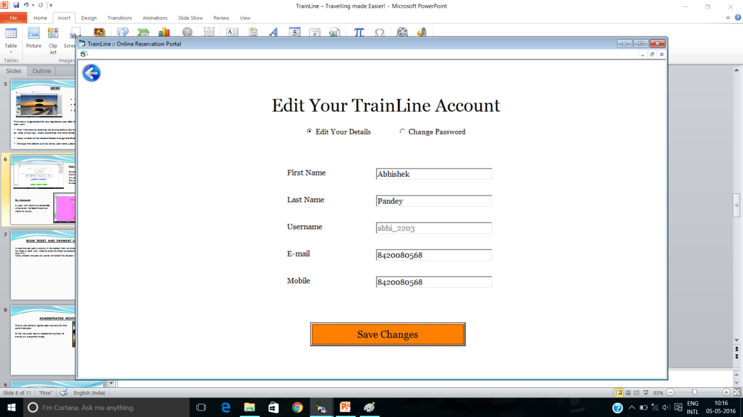
Plan My Travel:
Gives you a display of trains on that route. A click on your desired train gives the seat availability of all three coach classes.
My Account:
A user can edit his credentials whenever he feels there is a need to do so.

Slide 7
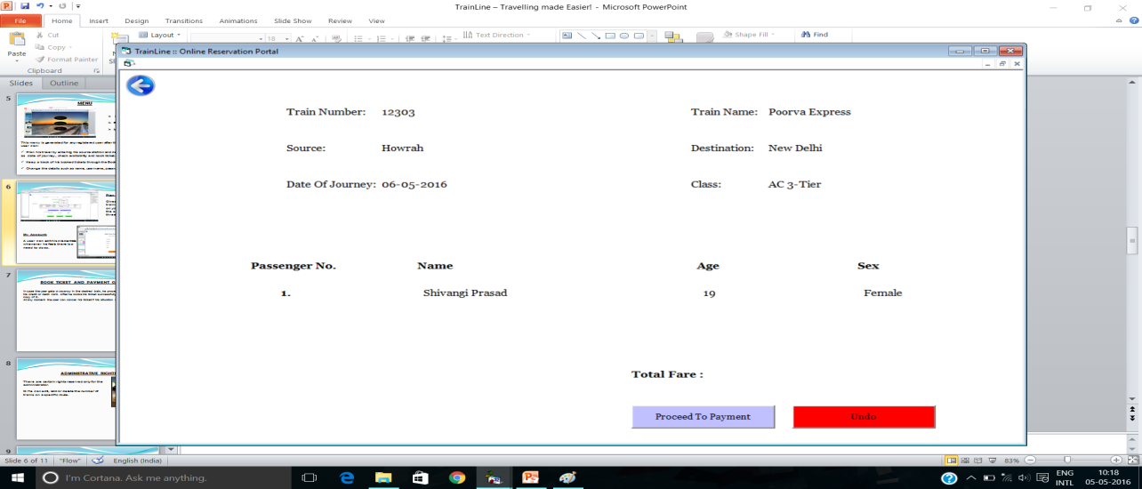
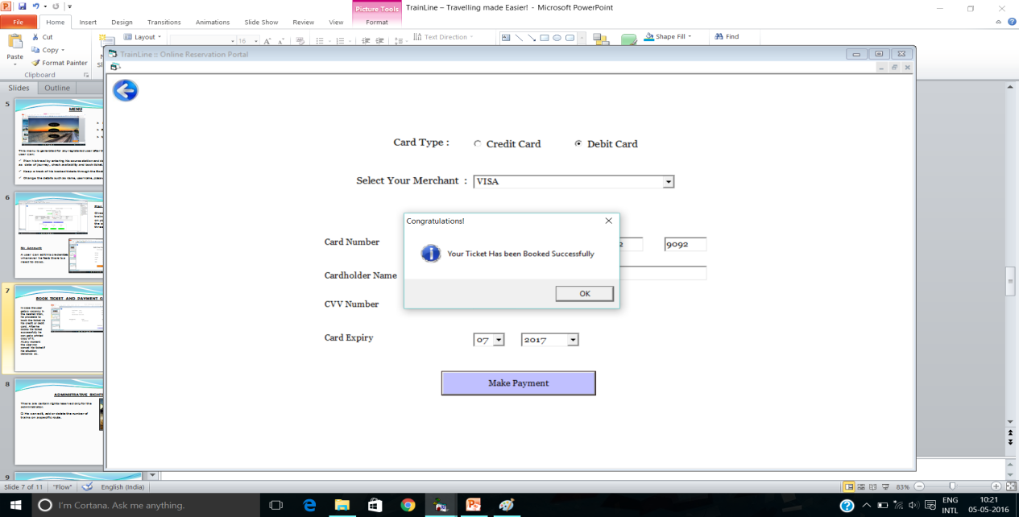
BOOK TICKET AND PAYMENT GATEWAY
In case the user gets a vacancy in the desired train, he proceeds to book the ticket via his credit or debit card. After he books his ticket successfully he can get a printed copy of it.
.

Slide 8
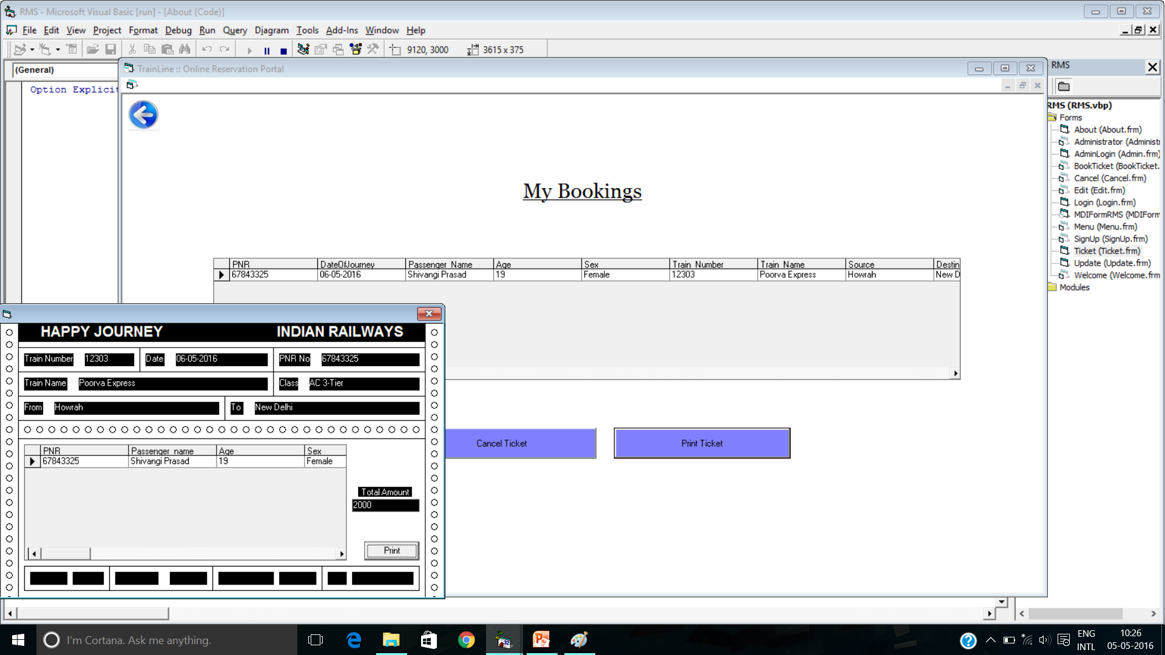
PRINT AND CANCEL TICKET
At any moment the user can cancel his ticket if his situation demands so.

Slide 9
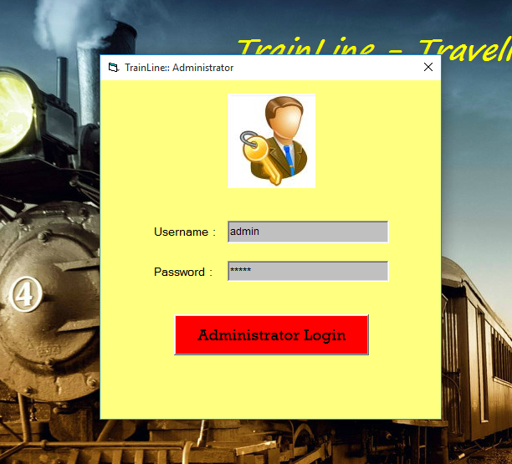
ADMINISTRATIVE RIGHTS
There are certain rights reserved only for the administrator.
He can edit, add or delete the number of trains on a specific route.
He can modify the number of seats in a train.

Slide 10
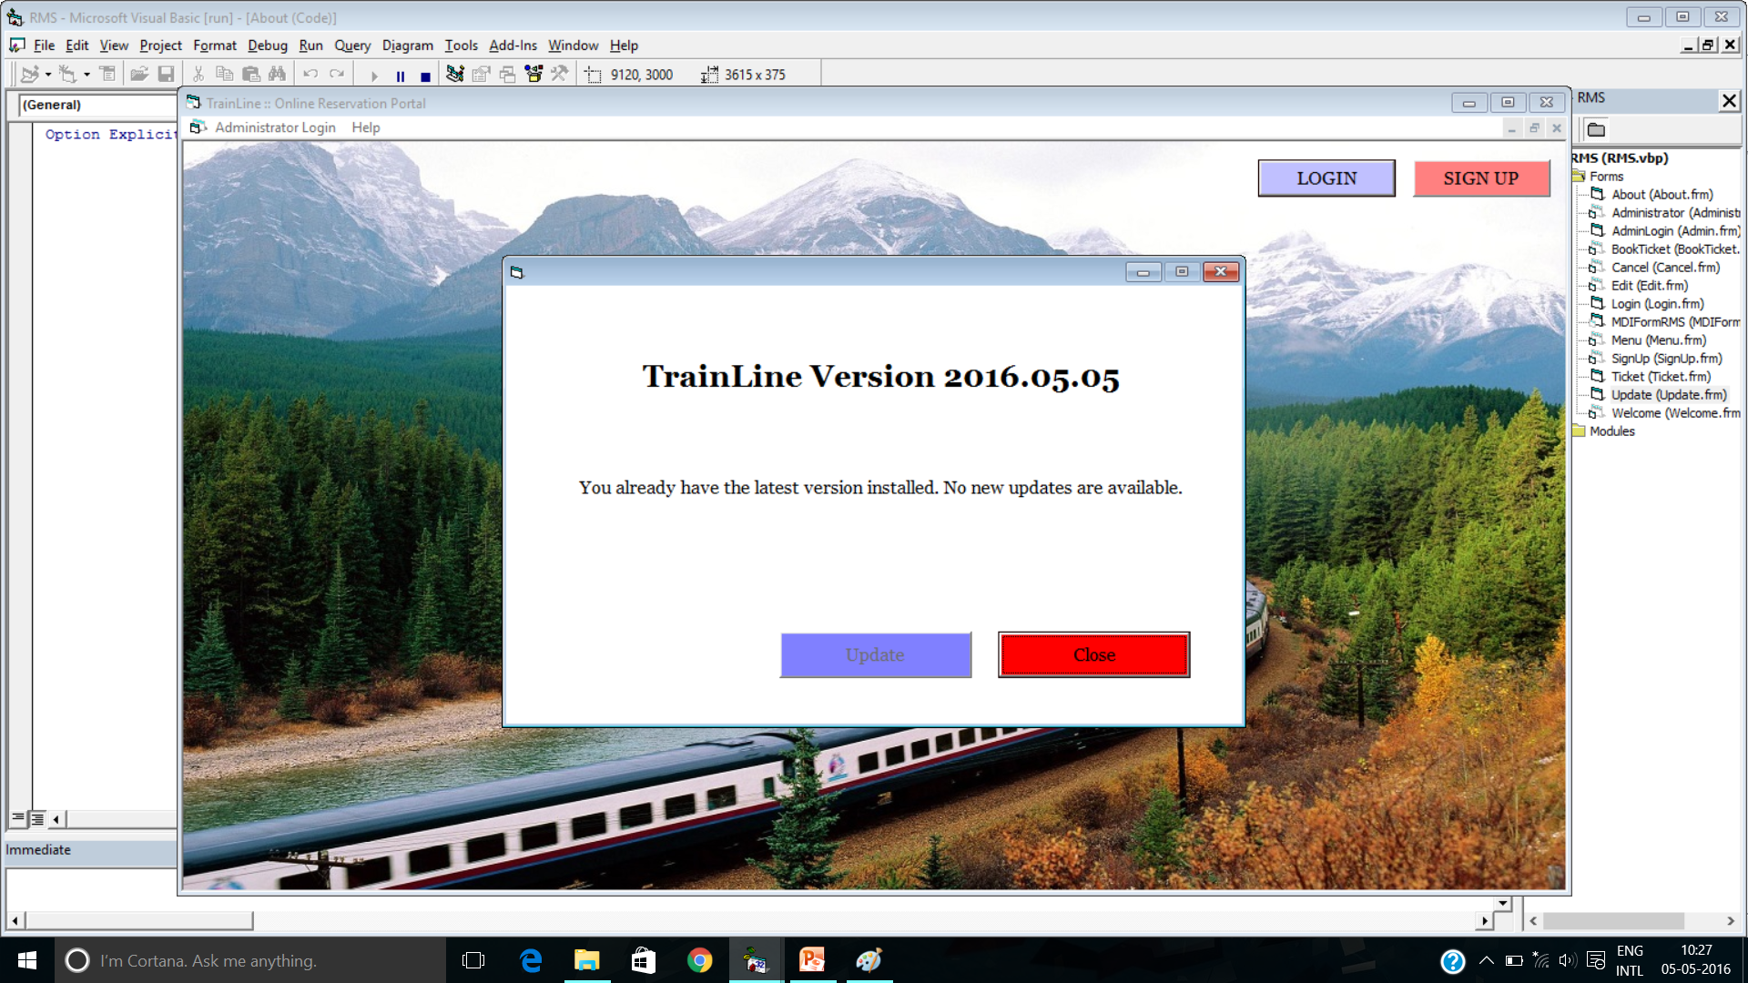
UPDATE
You can check for updates and update to the latest version of TrainLine when there is an update.

Slide 11
CONCLUSION
At TrainLine, we aim our best to provide quality service to all the users. Our welfare lies in the welfare of the customers. We hope you’ve benefited a lot from this project.

Slide 12
THANK YOU
I would like to thank S.Mitra Sir and Bibekananda Sir for giving us the opportunity to make this project. I would also like to thank my friends and group members for their constant support.

